Slide 1
Economics of Asylum Countries
Devika Bej - 2022111037
Bipasha Garg - 2022111006
Bassam Adnan- 2023121003

Slide 2
Abstract
The economic condition of a country depends on the people of the country, the population. This population can also include people who have seeked refuge in the country.
The economic state of a country can be studied by analysing many aspects such as GDP, unemployment rate, inflation rate, etc.
Our project seeks to visualize and analyse these two aspects of a country and seek to find a correlation between the two.

Slide 3
Dataset Description
Refugees Dataset (Link)
Aggregate Economics Dataset(Link)
Economics Dataset as % of GDP
This dataset contains the number of refugees migrating to or from the country in each year from 2000 to 2023. It can be further used to calculate the net difference in the country’s population owing to refugee movement.
This covers one aspect of the macroeconomics of a country - GDP, Purchasing Power Parity, etc. It is useful to see the growth/decline in its data as it corresponds to the growth/decline in the country’s prosperity.
This is another aspect of a country’s economics which is calculated as percentage of GDP - unemployment rate, inflation rate, and debt of the country. It is useful to study trends in these attributes together as they are correlated.

Slide 4
VISUALIZATIONS

Slide 5
DIFFERENT PAGES
HOME PAGE
SINGLE COUNTRY PAGE
COMPARE COUNTRY PAGE
The home page or landing page shows the world map with options for which data to view - number of incoming, outgoing refugees, net difference. User can also choose to view the map in grayscale.
The Single Country Page is the default page you land on upon clicking on a country. This page has a particle chart to visualise movement of refugees, bar and line charts for visualizing the economic data of the country, and a bubble chart.
The Compare Country Page can be accessed using a navbar upon clicking a country. This page has a double bar chart and a line chart to compare the economic data for two countries and their trends.

Slide 6
HOME PAGE: CHOROPLETH MAP/GEOMAP
A map to visualize the refugees dataset with a colour gradient to show increasing values
Toggle between grayscale and colour to experience the change in perception ability.
Use the slider to view the changes over the years.
A choropleth map offers a global perspective, making it easy to view the distribution of refugees in different regions of the world.
The year wise visualization can be used to map the migration to major world events.

Slide 7
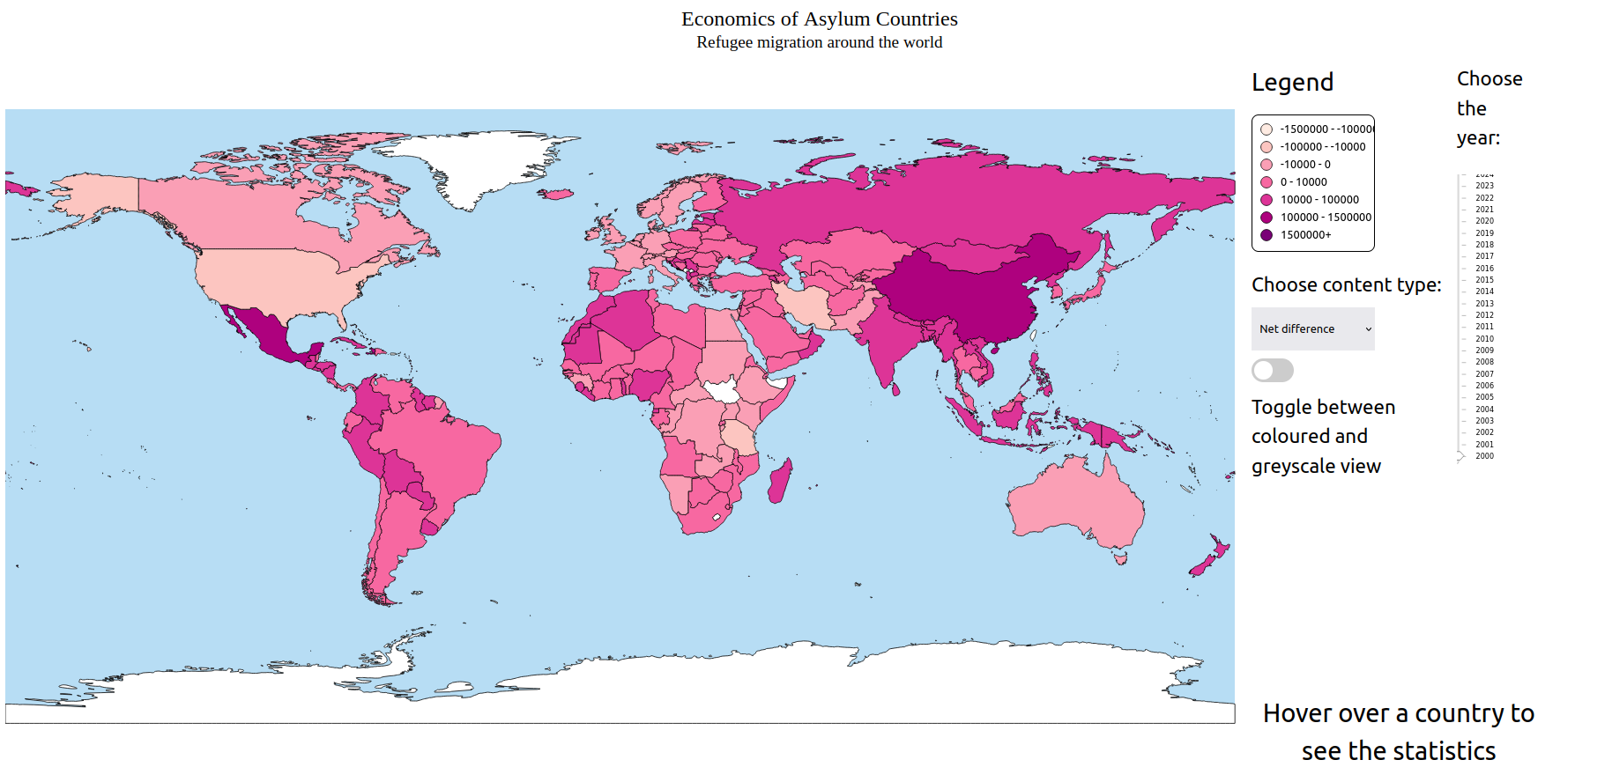
HOME PAGE: CHOROPLETH MAP/GEOMAP

Slide 8
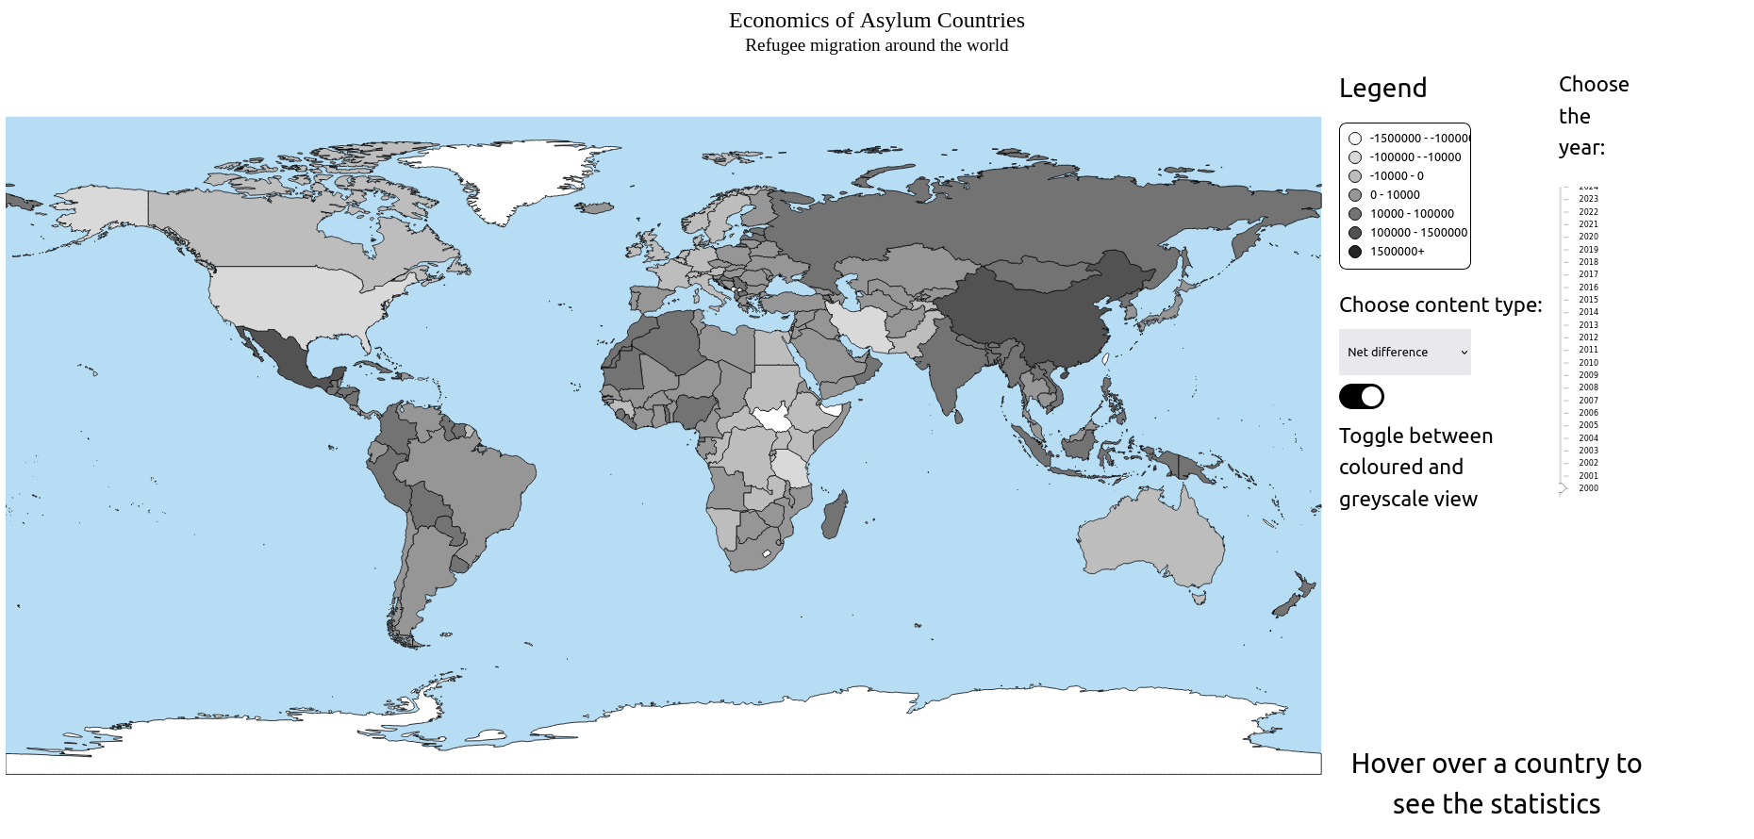
HOME PAGE: CHOROPLETH MAP/GEOMAP

Slide 9
SINGLE COUNTRY PAGE

Slide 10
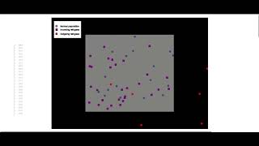
SINGLE COUNTRY PAGE
PARTICLE CHART
The Particle Chart uses point marks to visualize the refugee data for a particular country. There are multiple channels used in this visualization. Color and shape are used to signify categorical attribute - incoming refugee, outgoing refugee, normal population. The amount of particles signifies the high or low density of each category.
The particle chart is a beautiful way to visualize the density or sparseness of the population of a country and how the movement of refugees in and out of the country impacts it. An example would be if a country is already on the brink of overpopulation, and a lot of people migrate into the country. The chart for such a country would have a high degree of chaotic movement, implying an overcrowded atmosphere in the country.

Slide 11
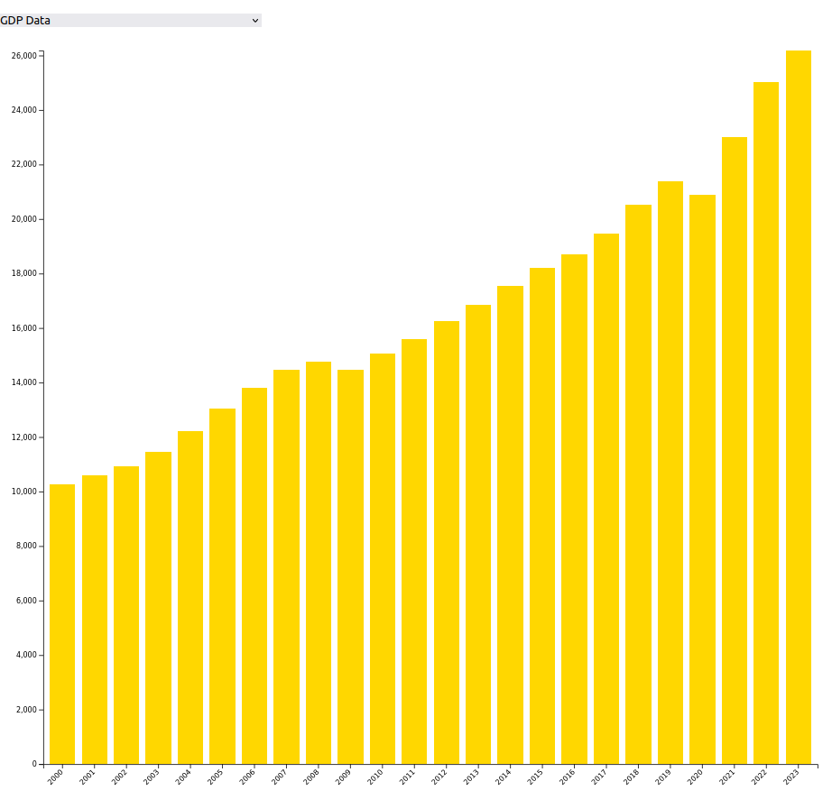
SINGLE COUNTRY PAGE
BAR CHART
A bar chart, where the bars are the marks and the channels are the horizontal position to show year and length of bar to show value of the data selected. The drop down menu allows the user to choose the economic aspect to visualise like GDP, per capita income for current prices, etc. Hovering over a bar enables a tooltip to show the exact value.
Bar charts provide a clear means for comparing values across different years, making it easy for economists and enthusiasts to identify trends and fluctuations in the data. They are well-suited for representing discrete data like years, with each bar representing a specific time period. This emphasis on individual years enables straightforward analysis of how specific economic parameters have evolved over time.

Slide 12
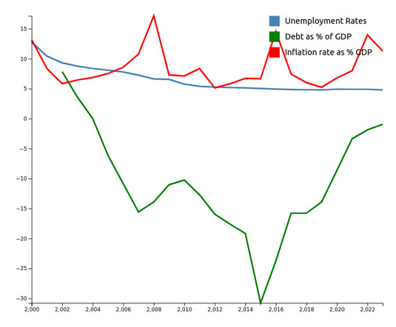
SINGLE COUNTRY PAGE
LINE CHART
A line chart with three types of data shown simultaneously, unemployment rate, inflation rate, and debt as percentage of GDP. The marks for the line graph is the point corresponding to each data point and the line joining them. The channels used are color as categorical channel to identify which line is for which data, x position to show the year for the datapoint, and y position to show the value of the datapoint.
A line chart is an effective tool for comparative and correlation analysis, allowing economists and enthusiasts to easily visualize trends and patterns across multiple variables like unemployment rates, inflation, and debt as a percentage of GDP over time. Its clarity enables users to identify correlations and understand the contextual relationship between economic indicators, offering a comprehensive view of the economic landscape.

Slide 13

SINGLE COUNTRY PAGE
BUBBLE CHART
We have added a bubble chart where we show different countries on the same parameters (such as Unemployment rate, inflation rate) in the same year. this comparison allows us to see how changes in unemployment rates correspond to changes in inflation or debt levels, providing a more comprehensive understanding of the economic landscape globally.
A bubble chart is an effective tool for comparative and correlation analysis, allowing economists and enthusiasts to easily compare multiple countries together by navigating the bubbles to different locations. The size and the color of the bubble depicts the range of the value corresponding to the country for the selected data, making it easier to read the visualization.

Slide 14
COMPARE COUNTRY PAGE

Slide 15
COMPARE COUNTRIES PAGE
DOUBLE BAR GRAPH
While the bar graph in single country page allowed one to study the economics of a country in detail.
This double bar graph allows the user to compare the country’s economic data with that of any other country.
This is especially useful when a historian would like to compare the data for two countries which were affected in a particular world event, e.g. The Russia - Ukraine War.
When interpreting data from a double bar graph, look for patterns or trends between the two variables.

Slide 16
COMPARE COUNTRIES PAGE
DOUBLE LINE GRAPH
While the line graph in single country page allowed one to study the economics of a country in detail.
This double line graph allows the user to compare the country’s economic data with that of any other country.
The double-line graph shows how data of two countries change over a period of time.
It provides an efficient way to display the relationship between two variables, such as economic data of 2 countries.
It also allows you to quickly spot trends and correlations between the two variables.
When interpreting data from a double line graph, look for patterns or trends between the two variables.
It’s also important to look for any extreme points or outliers that may be present in the data. If there are any major discrepancies between the two lines, it could indicate an issue that needs to be addressed.

Slide 17
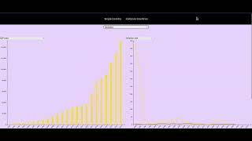

Slide 18
CONCLUSION
Data Correlation
The correlation of migration of refugees to asylum countries and the corresponding aftermath on the countries economics is the main aspect depicted in the visualization.
Visualization
The visualizations used are specifically aimed for the better understanding of the economists, historians, and the people wanting to study the trends.
Understandability
There are multiple different visualizations to make it easier for the user to understand and visualize the trends, patterns and data.

Slide 19
Timeline
PHASE 1 | PHASE 1 | PHASE 2 | PHASE 2 | PHASE 2 | PHASE 3 | PHASE 3 | PHASE 3
 |  |  | PHASE 2
PHASE 2
PHASE 1
PHASE 2
Making initial plan; Deciding on datasets and visualizations.
Making visualizations
Choropleth Map
Single & Country Compare page
Bar Chart
Particles Chart
Bubble Chart
Double Bar Chart
Double Line Chart
Line Chart
The country view

Slide 20



The Team
Bipasha Garg
Bassam Adnan
Devika Bej
LINE CHART
BUBBLE CHART
PARTICLE CHART
BAR CHART
CHOROPLETH MAP
COMPARE COUNTRIES PAGE

